Slide 1
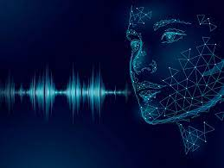
VOICE BASED INTELLIGENT VIRTUAL ASSISTANCE FOR WINDOWS
TEAM MEMBERS:
MALA.M - 211417104140
BHUVANESHWARI.S - 211417104313
SELVA SHANKARI.S - 211416104329
GUIDED BY
Mrs. SANGEETHA KRISHNAN
ASSISTANT PROFESSOR
DEPARTMENT OF CSE

Slide 2
ABSTRACT
PDAs(Personal Digital Assistants) also known as virtual assistants enhances a user’s productivity by proactively providing the information the user needs in the right context (i.e., time and place)
PDAs reactively answers a user’s questions and completes the tasks through natural language.
PDAs are now also deployed in tablets, laptops, desktop PCs, and headless devices (e.g., Amazon Echo), and some are also even integrated into operating systems.
PDAs make use of some core set of technologies, such as machine learning, speech recognition, LU, question answering (QA) and personalization.
The scenarios that the PDAs support can be divided into proactive and reactive assistance.
Even though proactive and reactive parts of the current PDA architectures are built in isolation, in principle they can use a single architecture to enable both types of experiences.
PDAs are complex systems with many components in the system stack, spanning client and multiple cloud services, and it is hard to separate any one component from the rest.

Slide 3
LITERATURE SURVEY:
Year | Title | Author | Description | Advantages | Disadvantages
2010 | Interacting with Embodied Conversational Agents | Elizabeth Andre, Catherine Pelachaud | It focuses to develop more human-centred , personalized and more engaging speech-based interactive systems immediately leads to the embodied conversational agent (ECA) that employs gestures, mimics and speech to communicate with the human user. | Gesture recognition has gained Considerable attention in emerging Applications to provide a better user experience for human- computer interaction | These solutions are either easily affected by the Environmental noise or incapable of sensing fine-grained gestures at the finger level.

Slide 4
LITERATURE SURVEY(CONTD..):
Year | Title | Authors | Description | Advantages | Disadvantages
2013 | Mmdaget - A Fully Open-source Toolkit For Voice Interaction Systems | Gokiso-cho, Showa-ku, Nagoya | It focuses on development of an open-source toolkit which makes it possible to explore a vast variety of aspects in speech interactions at spoken dialog systems and speech interfaces. | On-line speaker interpolation is supported, so one can merge several speaker model at run time to produce speech of various speaking styles. | Existing datasets have been collected under controlled laboratory conditions and methods have been not evaluated across multiple datasets

Slide 5
LITERATURE SURVEY(CONTD..):
Year | Title | Authors | Description | Advantages | Disadvantages
2017 | The Technology Behind Personal Digital Assistants | Ruhi Sarikaya | It focuses on enhancing a user’s productivity by proactively providing the information the user and reactively answering a user’s questions and completing tasks through natural language | Expanded association. Broad Internet Connectivity | Operation errors. Lack of competence. Speech recognition challenges

Slide 6
LITERATURE SURVEY(CONTD..):
Year | Title | Authors | Description | Advantages | Disadvantages
2018 | Web-based environment for user generation of spoken dialog for virtual assistants | Ryota Nishimura , Daisuke Yamamoto, Takahiro Uchiya and Ichi Takumi | It focuses on a web-based spoken dialog generation environment which enables users to edit dialogs with a video virtual assistant is developed and to also select the 3D motions and tone of voice for the assistant. | Allows anyone to easily edit spoken dialog content and other virtual video assistant features such as tone of voice, facial expression, and body motion | Detailed information can be difficult to convey using . Users may be unaware of what topics they can talk about.

Slide 7
LITERATURE SURVEY(CONTD..):
Year | Title | Authors | Description | Advantages | Disadvantages
2020 | Voice based Intelligent Virtual Assistance for Windows 7 | C.Selvarathi, Dr. B. Padminidevi | The proposed system was based on the voice recognition in commands which converts the speech to text. It uses LGB algorithm functions which will train the VQ codebook. | It converts text to speech .It will assist you to find the applications easily. It can be used in windows 7. | Data need to be entered properly otherwise outcome may won’t be accurate. The user who are deaf and dumb cant able to access this.

Slide 8
PROBLEM STATEMENT
The common people can be able to identify the speech recognition devices and hence easily control them.
Whereas the blind people cannot able to handle those devices around them .
However, speech recognition and machine getting to know the input format and based on the input it will served desired output through in build packages and APIs.
The system uses speech or text to communicate with the user. Speech recognition uses to convert the speech/voice input into text format.
Then given converted input is parsed by the system and tokens are generated using algorithms and built in APIs which generates desired output in speech or text format..
The system was tested to feed the news, news are shown in text as well as it will be read by the system so it would be useful for visual impaired people as well.

Slide 9
TECHNOLOGY STACK:
SOFTWARE ENVIRONMENT:
Operating System : Windows 7 , 8, 10 (64 bit)
Software : Python and Anaconda
Tools : Jupyter Note Book and Spyder IDE
HARDWARE ENVIRONMENT:
Hard Disk : 500GB and Above
RAM : 4GB and Above
Processor : I3 and Above
Webcam - 2
Arduino UNO, Gesture Sensors, relay circuit board

Slide 10
TECHNOLOGY STACK (CONTD..):
PYTHON
Python packages
PySimple GUI
Pyttsx3
speechRecognition
PyAudio
Requests
Json

Slide 11
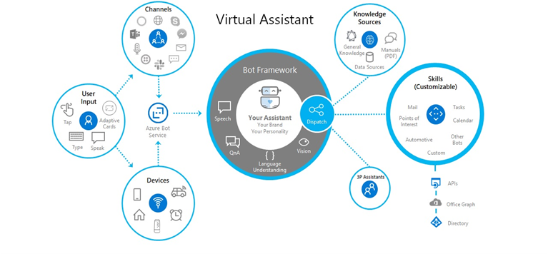
SYSTEM ARCHITECTURE

Slide 12
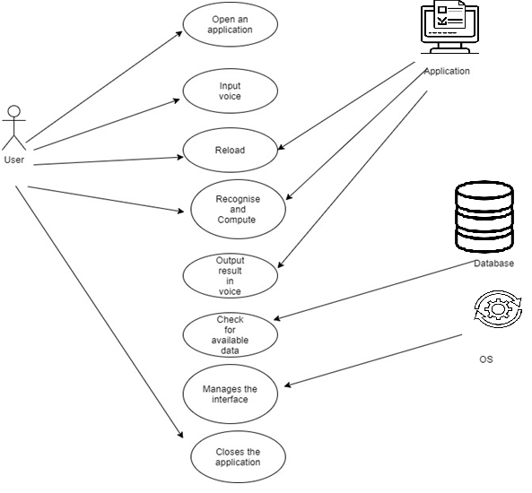
USE CASE DIAGRAM

Slide 13
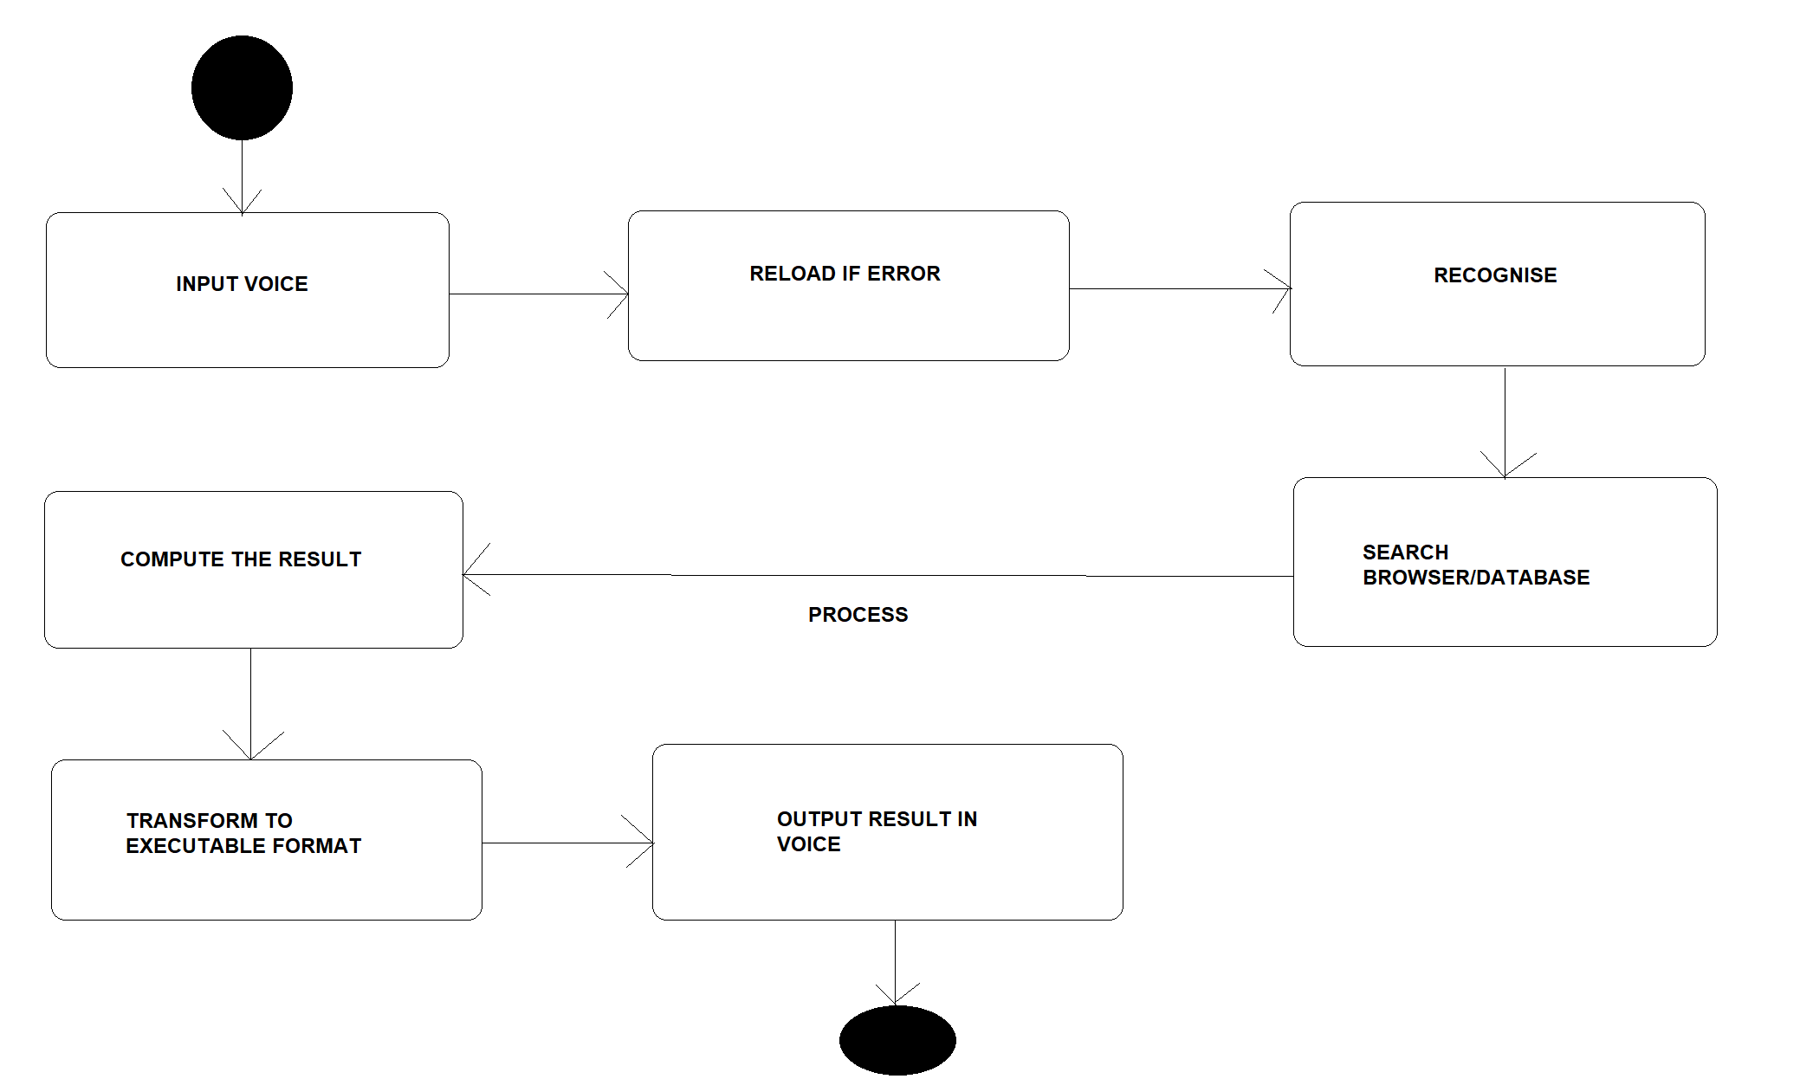
STATE DIAGRAM

Slide 14
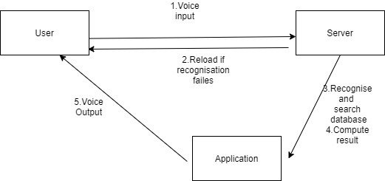
COLLABORATION DIAGRAM

Slide 15
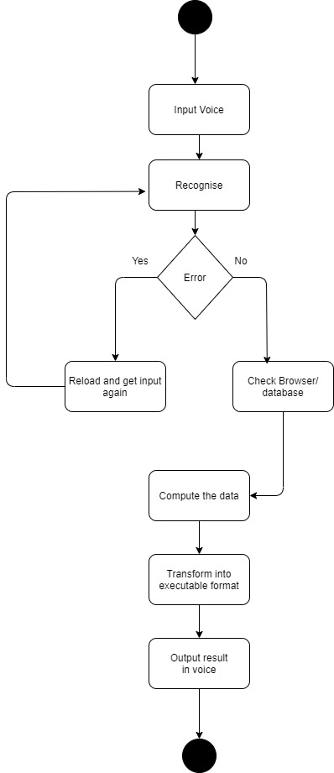
ACTIVITY DIAGRAM

Slide 16
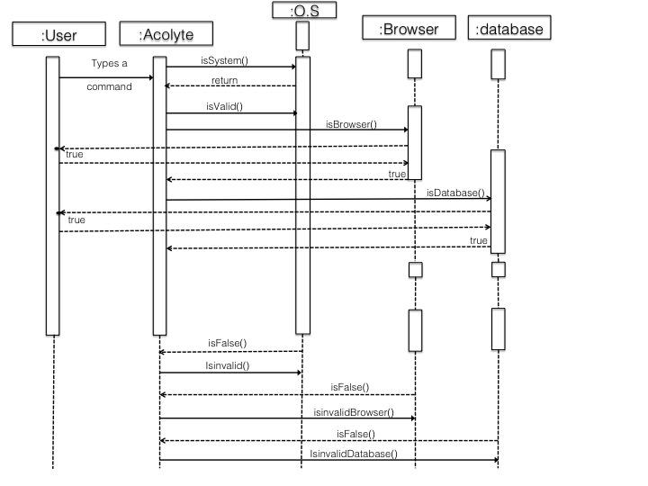
SEQUENCE DIAGRAM

Slide 17
MODULE DESCRIPTION
There are three modules in our project .The list of modules are as follows:
Speech to text
Command execution
Text to speech

Slide 18
MODULE 1: SPEECH TO TEXT MODULE
User will ask the computer to run command by giving input as speech.
The speech processing system includes a speech recognizer residing on a first computing device and a speech model server residing on a second computing device.
The speech recognizer receives speech training data and processes it into an intermediate representation of the speech training data.

Slide 19
MODULE 2 : COMMAND EXECUTION
Command Execution: Based on command received from the user, system will execute the command (if available). e.g. Open Notepad, Paint, Google Chrome, etc.
System accept various command such as opening of specific applications, writing a note and saving it, opening web URL, Search for any query or details and shutdown & Restart command

Slide 20
MODULE 3:TEXT TO SPEECH
Once a command is received, application speaks the command which makes user experience more interactive with the system.
The converter has been compiled in a library which provides an Application Programming Interface (API) to the applications.

Slide 21
TESTING
Black-box testing
It is carried out to test functionality of the program. It is also called ‘behavioral’ testing. The tester in this case, has a set of input values and respective desired results. On providing input, if the output matches with the desired results, the program is tested ‘ok’, and problematic otherwise.
White-box testing
It is conducted to test program and its implementation, in order to improve code efficiency or structure. It is also known as ‘structural’ testing.
Unit testing
While coding, the programmer performs some tests on that unit of program to know if it is error free. Testing is performed under white-box testing approach. Unit testing helps developers decide that individual units of the program are working as per requirement and are error free.

Slide 22
TESTING (contd:)
System Testing
The software is compiled as product and then it is tested as a whole. This can be accomplished using one or more of the following tests
Integration Testing
Even if the units of software are working fine individually, there is a need to find out if the units if integrated together would also work without errors. For example, argument passing and data updation etc.

Slide 23
PEFORMANCE ANALYSIS
TECHNICAL FEASIBILITY:
for the real time project, we are using python and the platform used for python is anaconda which is platform independent. Therefore the project is technically feasible.
Economic feasibility:
this project we are dealing the project in hardware manner, therefore the cost may be economically high. But in this we are using python programming it reduces the lines of code and increases the performance.

Slide 24
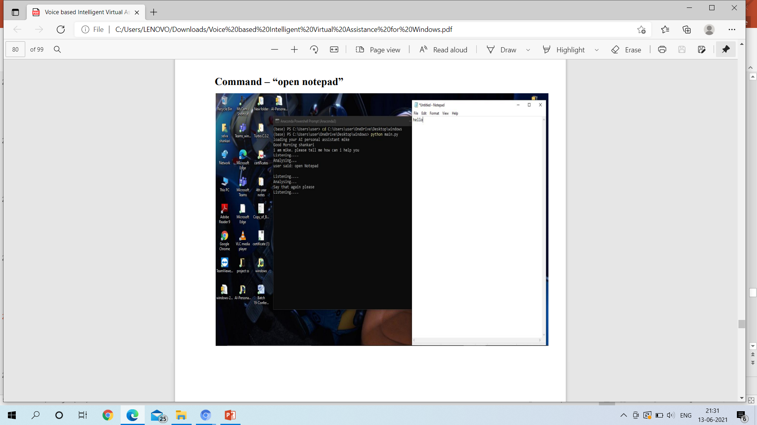
SCREENSHOTS

Slide 25
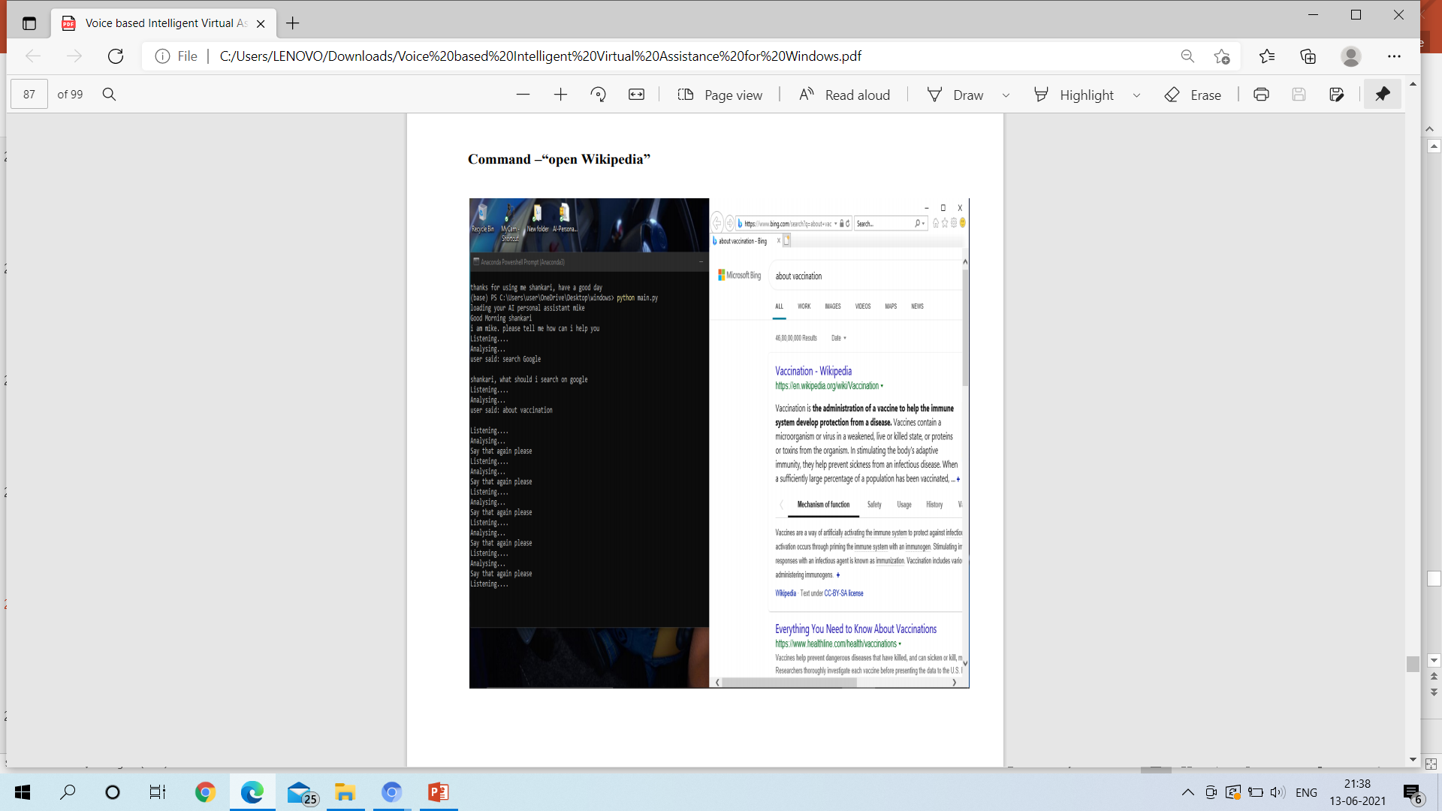

Slide 26
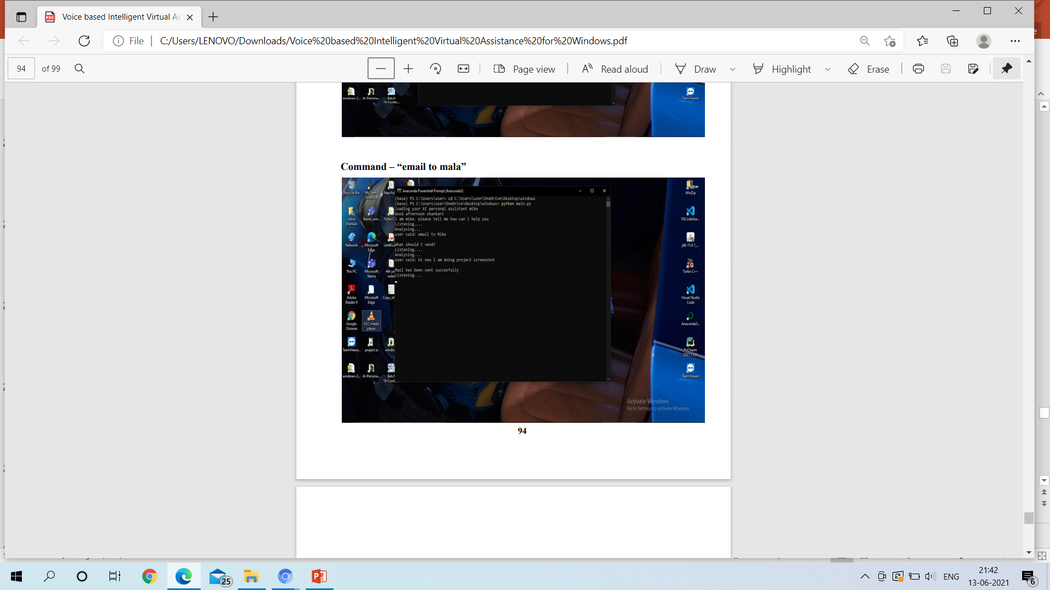

Slide 27
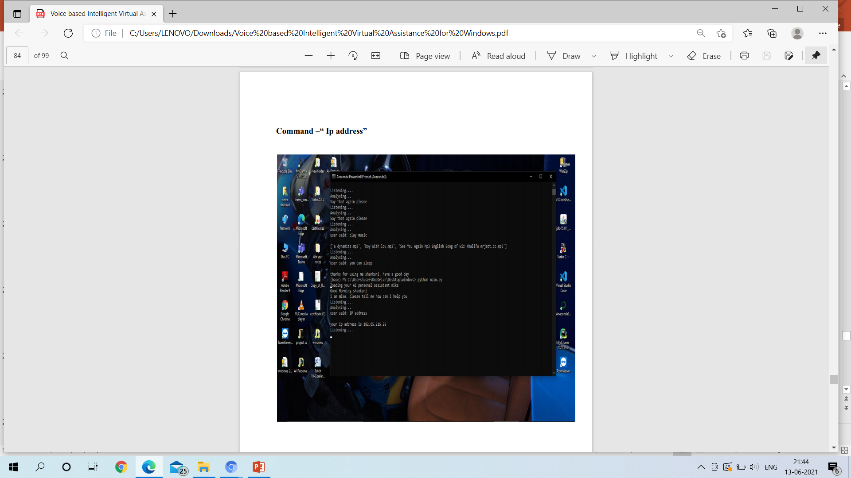

Slide 28
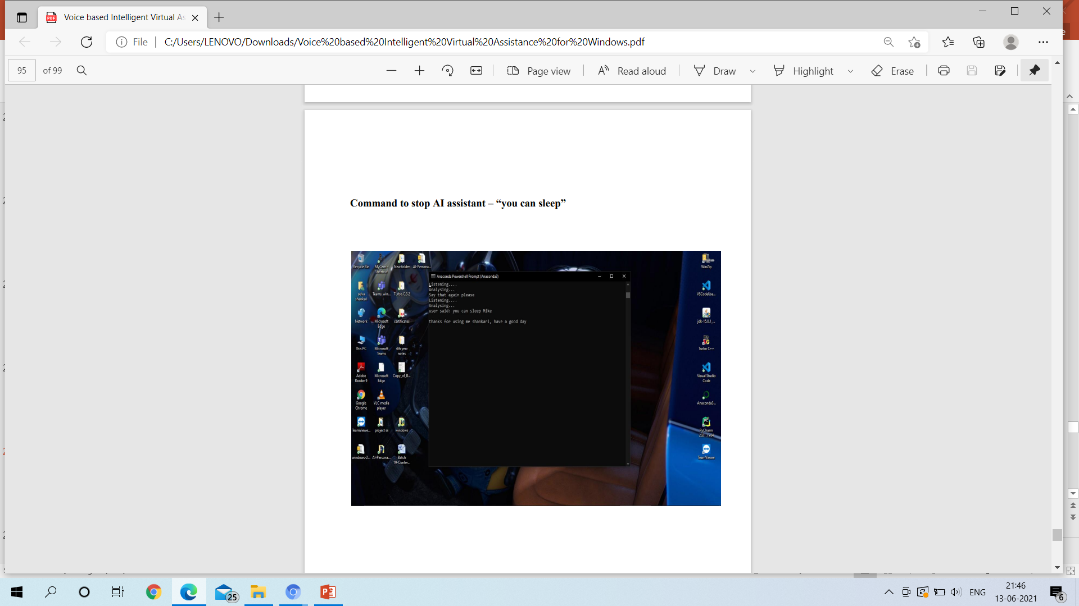

Slide 29
CONCLUSION
In this project we proposed an voice recognition system called Personal Digital Assistance .
Here, we proposed a spoken dialog content generation system which relies on user-generated content.
Personal Digital Assistant helpful for normal people and blind/visually impaired by having the natural dialogue with the system.
The modules of this system makes it flexible , easy to use and easy to add additional features without disturbing current system functionality.
In this research, a method to effectively collect usergenerated contents was proposed, and also surveys were conducted on the number of contributors and the content type.
As future work, we would like to investigate if recognition of the virtual assistant’s speech by users is improved when the system simultaneously provides corresponding visual information.

Slide 30
REFERENCES
A. Lee, K. Oura, K. Tokuda, in 2013 IEEE International Conference on Acoustics, Speech and Signal Processing. MMDAgent - A fully open-source toolkit for voice interaction systems
H. Kawanami, S. Takeuchi, R. Torres, H. Saruwatari, K. Shikano, in Proceedings of the Asia-Pacific Signal and Information Processing Association Annual Summit and Conference
K. VanLehn, P.W. Jordan, C.P. Rosé, D. Bhembe, M. Böttner, A. Gaydos, M. Makatchev, U. Pappuswamy, M. Ringenberg, A. Roque, et al., in International Conference on Intelligent Tutoring Systems. The architecture of why2-atlas:
S. Seneff, E. Hurley, R. Lau, C. Pao, P. Schmid, and V. Zue, “Galaxy-II: A reference architecture for conversational system development,”
M. Henderson, B. Thomson, S. Young. Word-based dialog state tracking with recurrent neural networks.

Slide 31
REFERENCES(CONTD..)
J.D. Williams, S. Young, Partially observable Markov decision processes for spoken dialog systems. Comput. Speech Lang.
M. Henderson, B. Thomson, S. Young. Word-based dialog state tracking with recurrent neural networks
R. Nishimura, D. Yamamoto, T. Uchiya, I. Takumi, in Proceedings of the Second International Conference on Human-agent Interaction. HAI ’14. Development of a dialogue scenario editor on a web browser for a spoken dialogue system (ACM, New York, 2014)
HTS Working Group, Open JTalk: The Japanese TTS System
A. Lee, T. Kawahara, in Proceedings of the Asia-Pacific Signal and Information Processing Association Annual Summit and Conference 2009 (APSIPA2009). Recent development of open-source speech recognition engine julius

Slide 32
THANK YOU

